Slide 1
Detecting Extreme Events Using Gaussian Mixture Models
Aytaç Paçal^{1,2}, Birgit Hassler¹, Katja Weigel^{2,1}, Levent Kurnaz⁴, Michael Wehner³, Veronika Eyring^{1,2}
¹ Deutsches Zentrum für Luft- und Raumfahrt e.V. (DLR), Institute of Atmospheric Physics, Oberpfaffenhofen, Germany
² University of Bremen, Institute of Environmental Physics (IUP), Bremen, Germany
³ Computational Research Division, Lawrence Berkeley National Laboratory, Berkeley, CA, USA
⁴ Center for Climate Change and Policy Studies, Boğaziçi University, Istanbul, Turkey
Paçal, A., Hassler, B., Weigel, K., Kurnaz, M. L., Wehner, M. F., & Eyring, V. (2023). Detecting extreme temperature events using Gaussian mixture models. Journal of Geophysical Research: Atmospheres, 128, e2023JD038906. https://doi.org/10.1029/2023JD038906

Slide 2
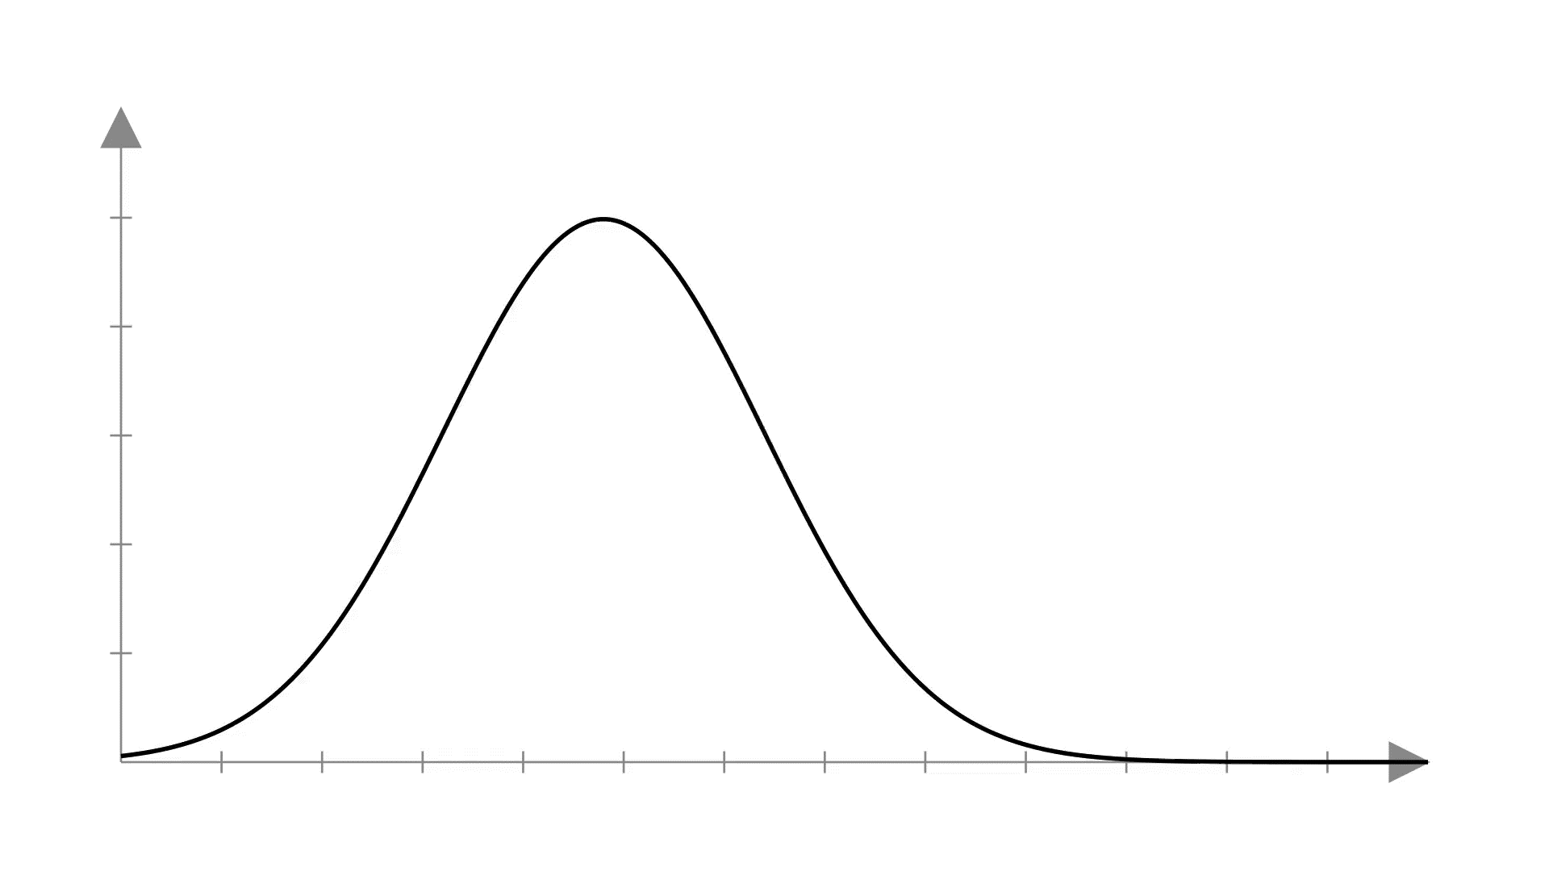


Identifying extreme temperature events is crucial due to the significant risks they pose to human society and the environment.
Climate change is altering the distribution of temperatures, leading to increasingly frequent and severe extreme temperature events.
Current methods for defining an extreme temperature event typically assume a unimodal distribution.
Notes:
Climate change is changing temperature distribution, causing more frequent and severe extreme temperature events.

Slide 3
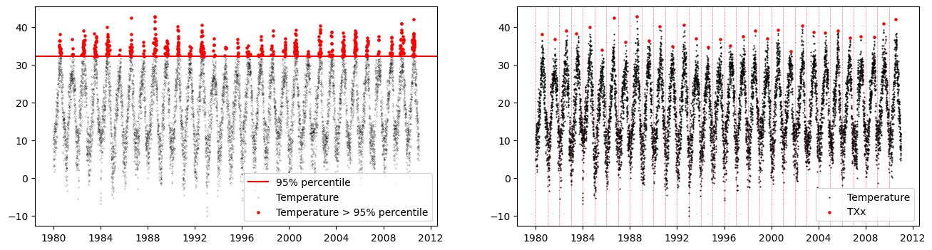
Two standard approaches to detect extreme events are the percentile-over-threshold (POT) and the block maxima method.

Slide 4
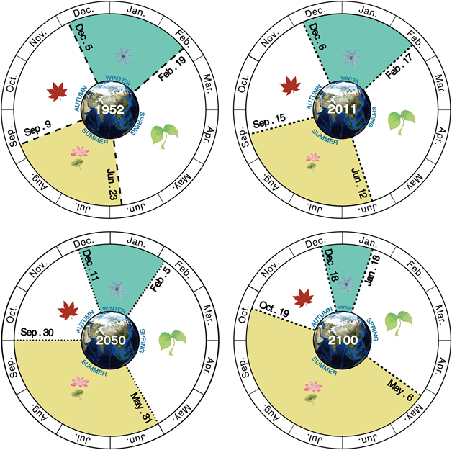
However, onsets and length of seasons are predicted to change with climate change.
Wang, J., Guan, Y., Wu, L., Guan, X., Cai, W., Huang, J., et al. (2021). Changing lengths of the four seasons by global warming. Geophysical Research Letters, 48, e2020GL091753. https://doi.org/10.1029/2020GL091753

Slide 5
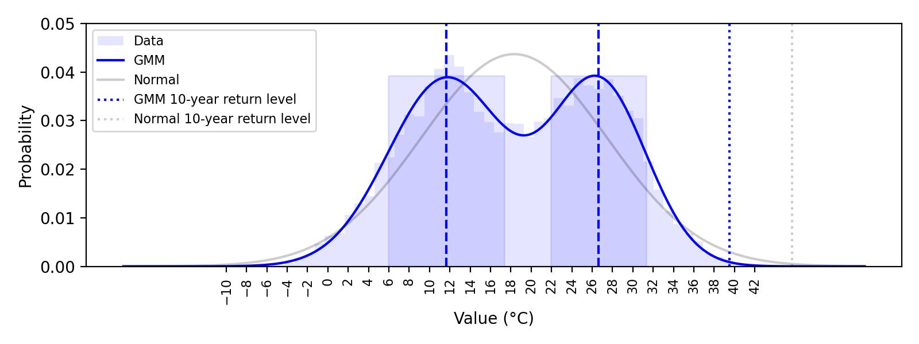
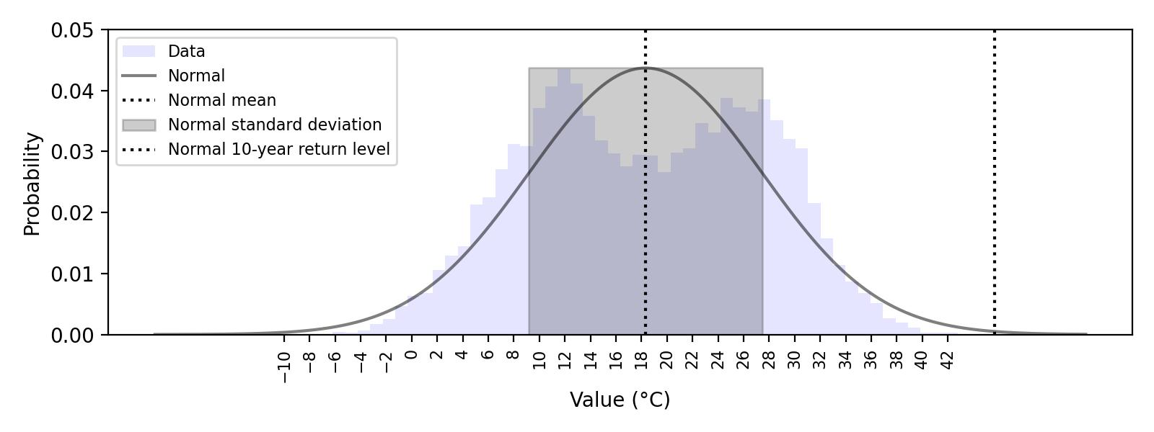
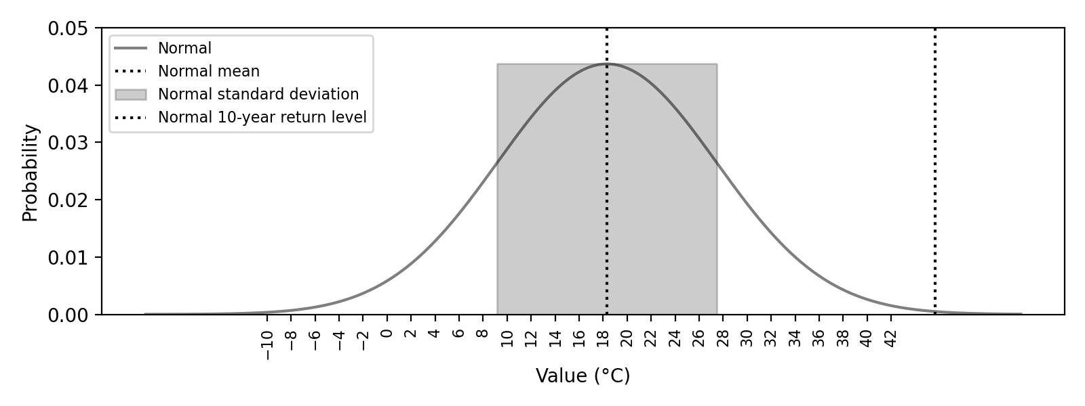
Can we find extreme events from multi-year daily maximum temperature data?

Slide 6
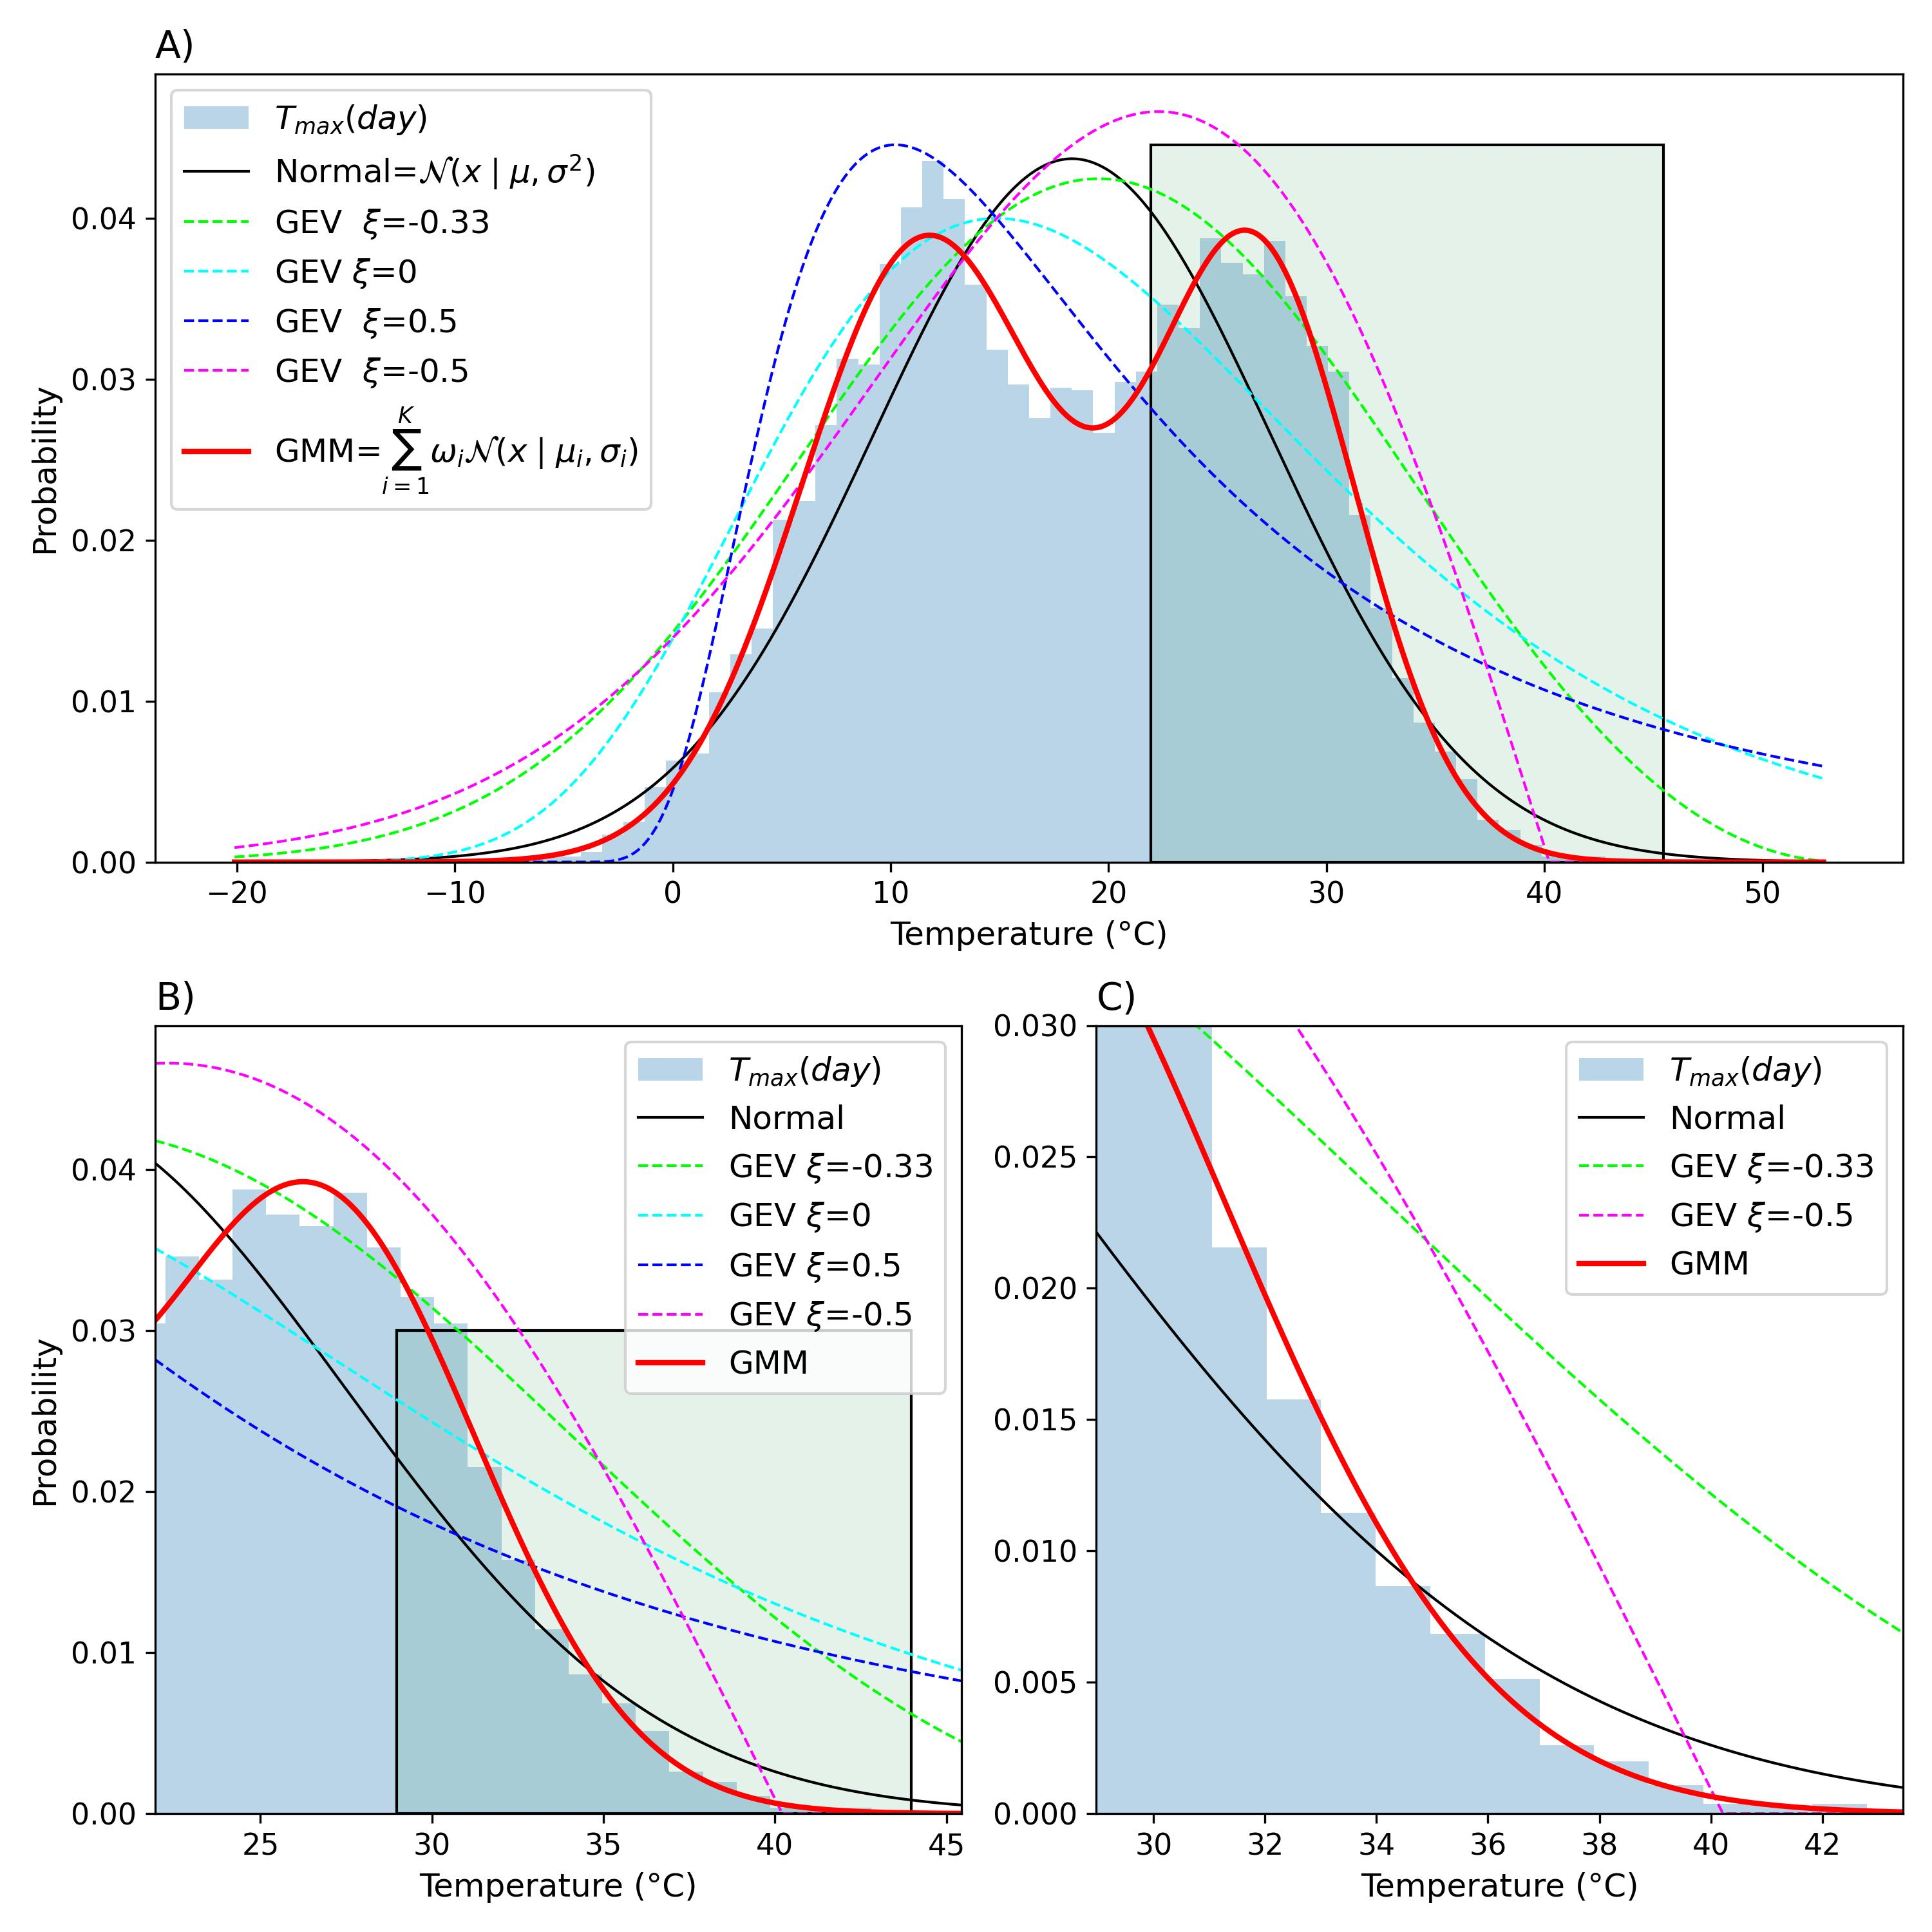
GMM vs. unimodal distributions
We test the goodness-of-fit for different unimodal distributions
Normal
GEV distributions
GMM distribution

Slide 7
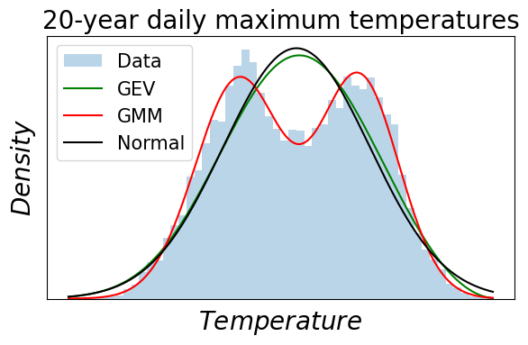


Can we find extreme events from the whole temperature distribution data?
Daily maximum temperatures follow mostly a bimodal distribution, and a unimodal distribution is not a good fit for bimodal data.
Gaussian Mixture Models (GMM) is a probabilistic model that describes the data points in a population as a mixture of Gaussian distributions.

Slide 8
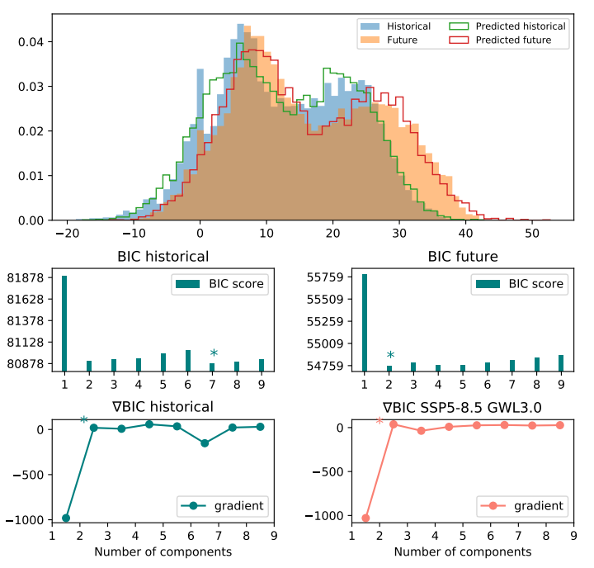
Choosing the best number of components
BIC scores penalize adding more parameters
Unimodality tests

Slide 9
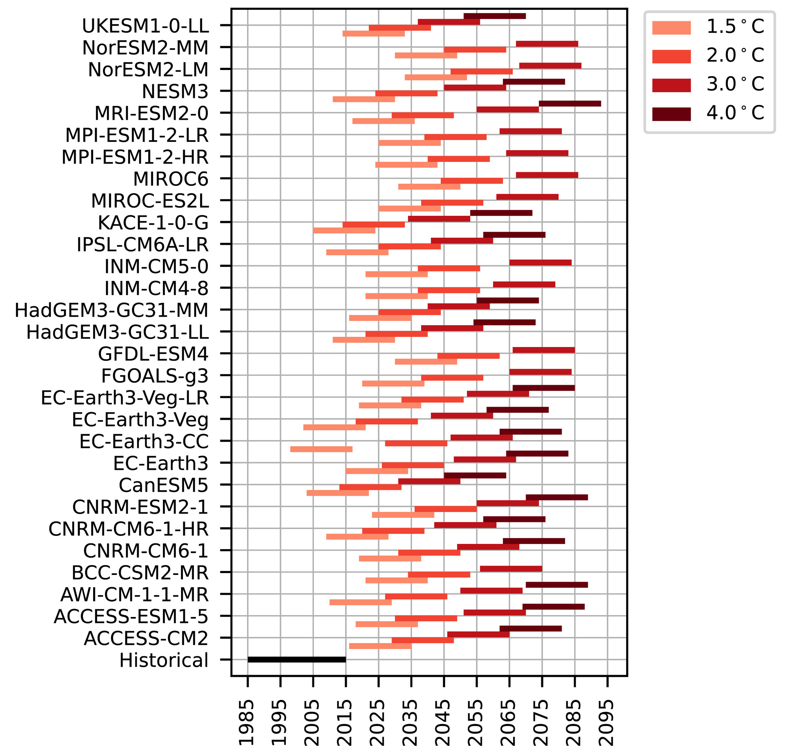
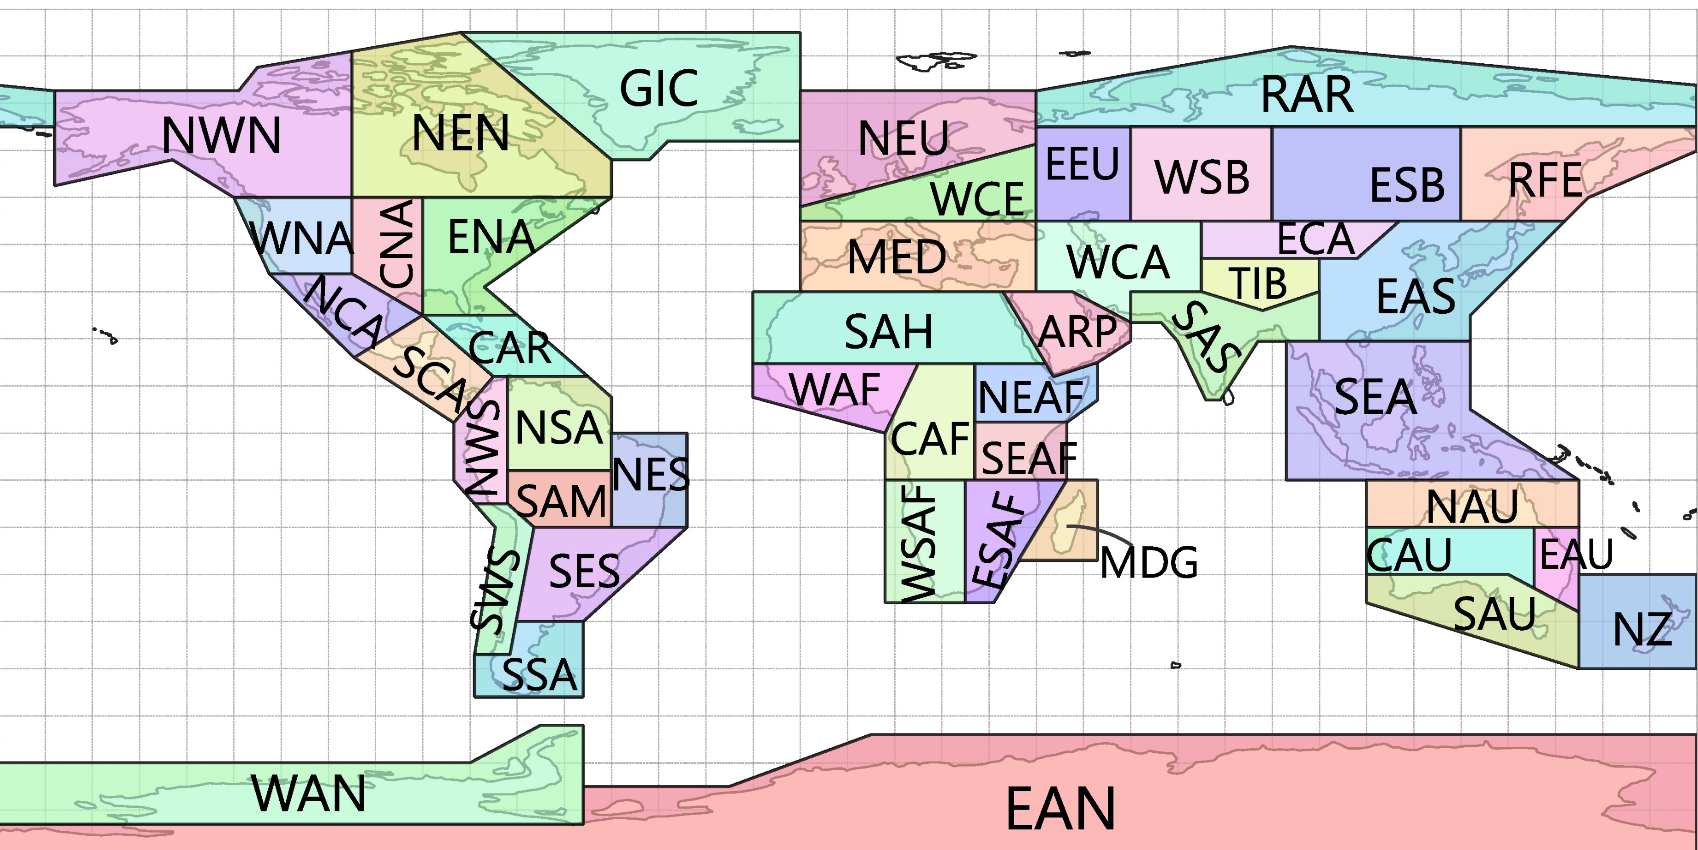
We used temperature data from CMIP6 simulations under Global Warming Levels (GWL).
Daily Maximum Near-Surface Air Temperature
29 CMIP6 Datasets
Shared Socioeconomic Pathways (SSP)
Historical (Base) period: 1985-2014
Future periods: 20-year periods exceeding GWL
46 IPCC Land regions

Slide 10
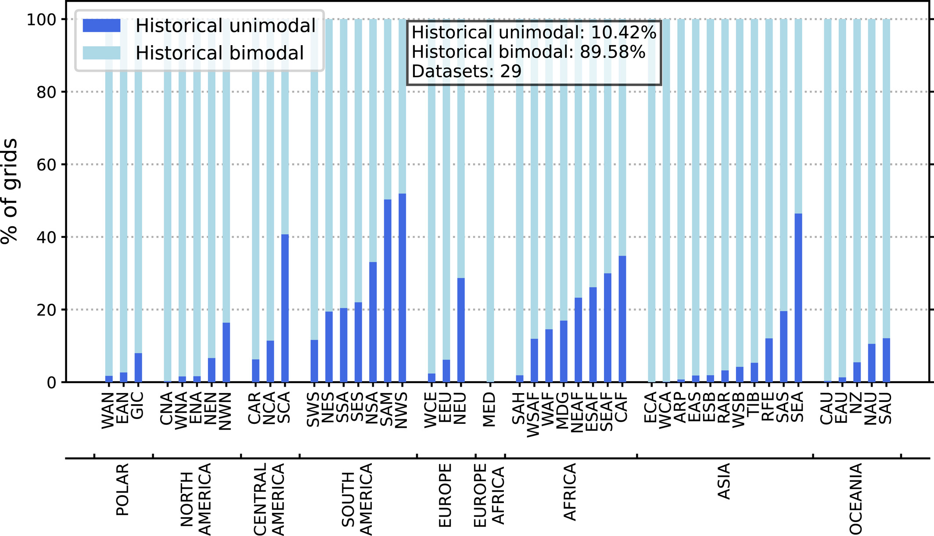

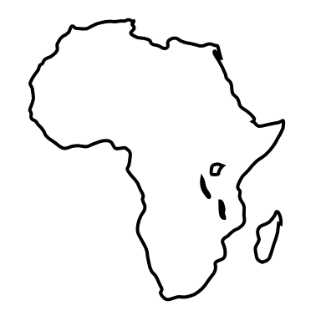
In all regions, most grid cells follow bimodal distribution.

Slide 11
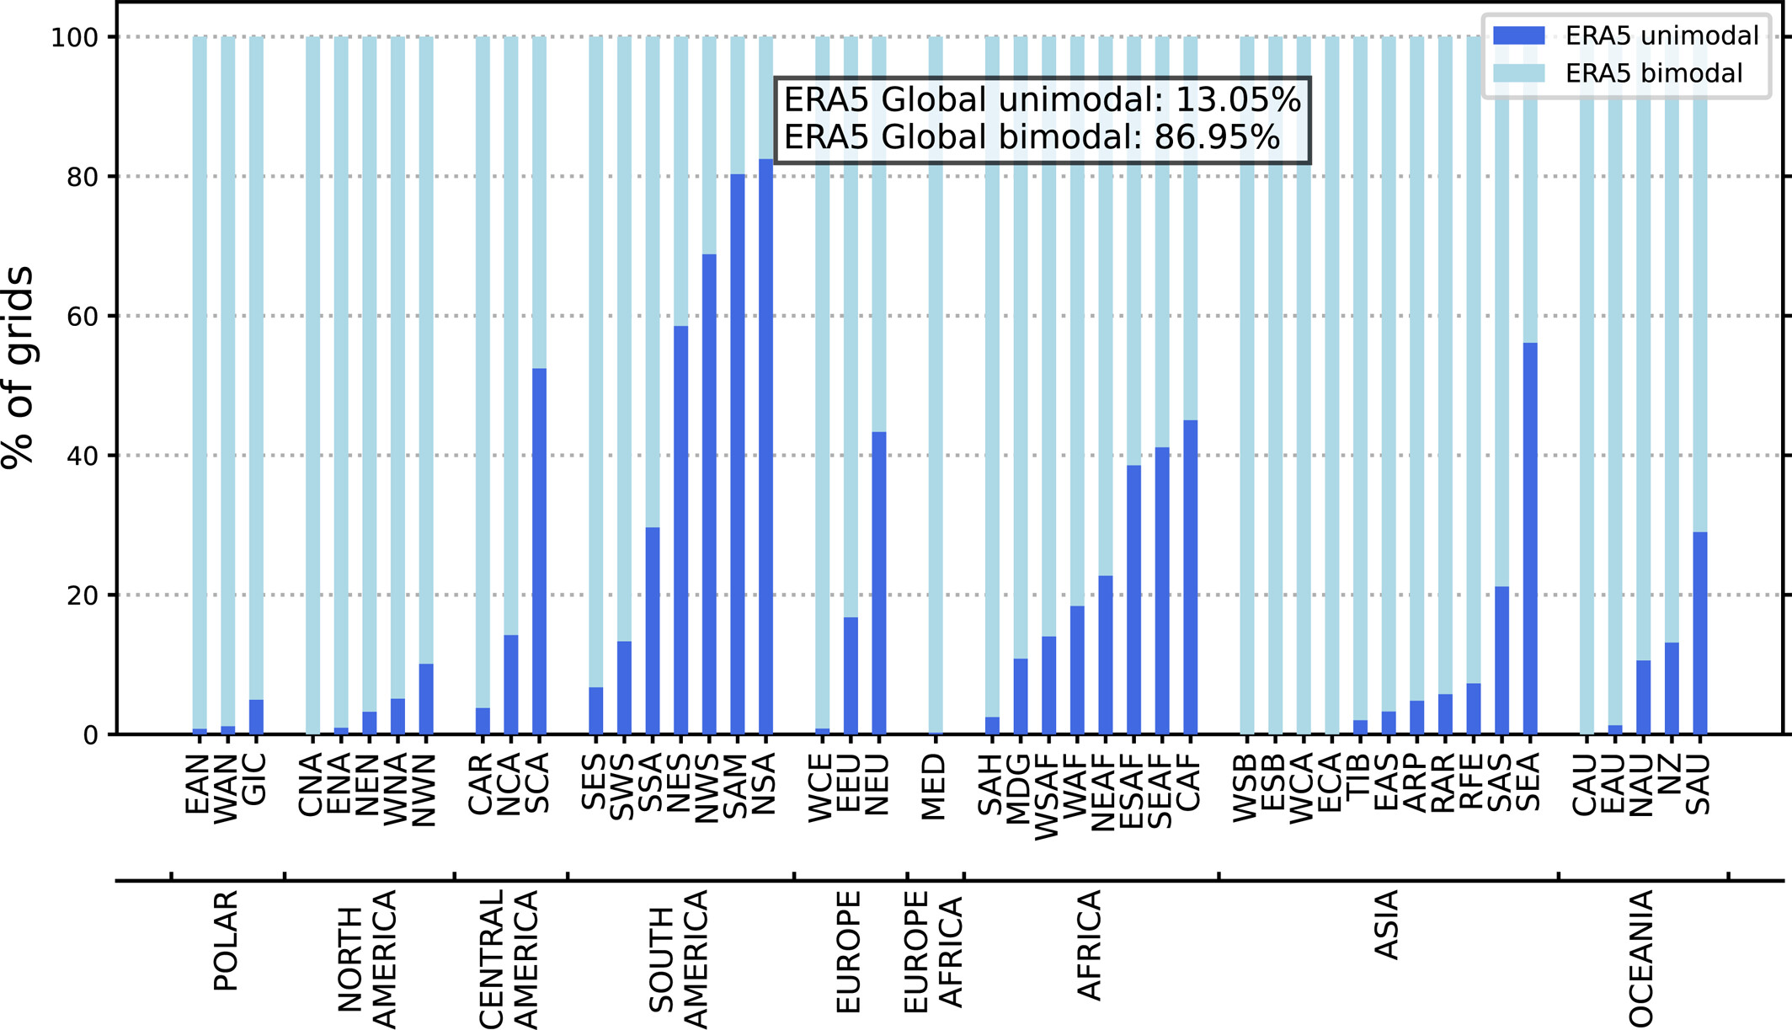
In all regions, most grid cells follow bimodal distribution.

Slide 12

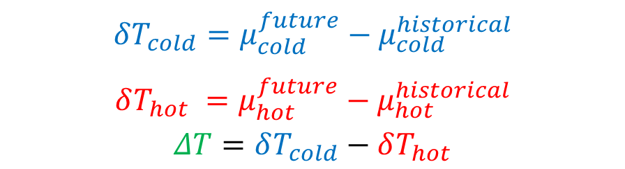
We analysed the movement of the peaks in bimodal distributions.
Historical
Future
$$δT_{cold}=μ_{cold}^{future}−μ_{cold}^{historical}$$
$δT_{hot} =$ $μ_{hot}^{future}−μ_{hot}^{historical}$
$$ΔT=δT_{cold}−δT_{hot}$$
Notes:
We defined the leftmost Gaussian as cold Gaussian
Rghtmost Guassian as hot Gaussian

Slide 13



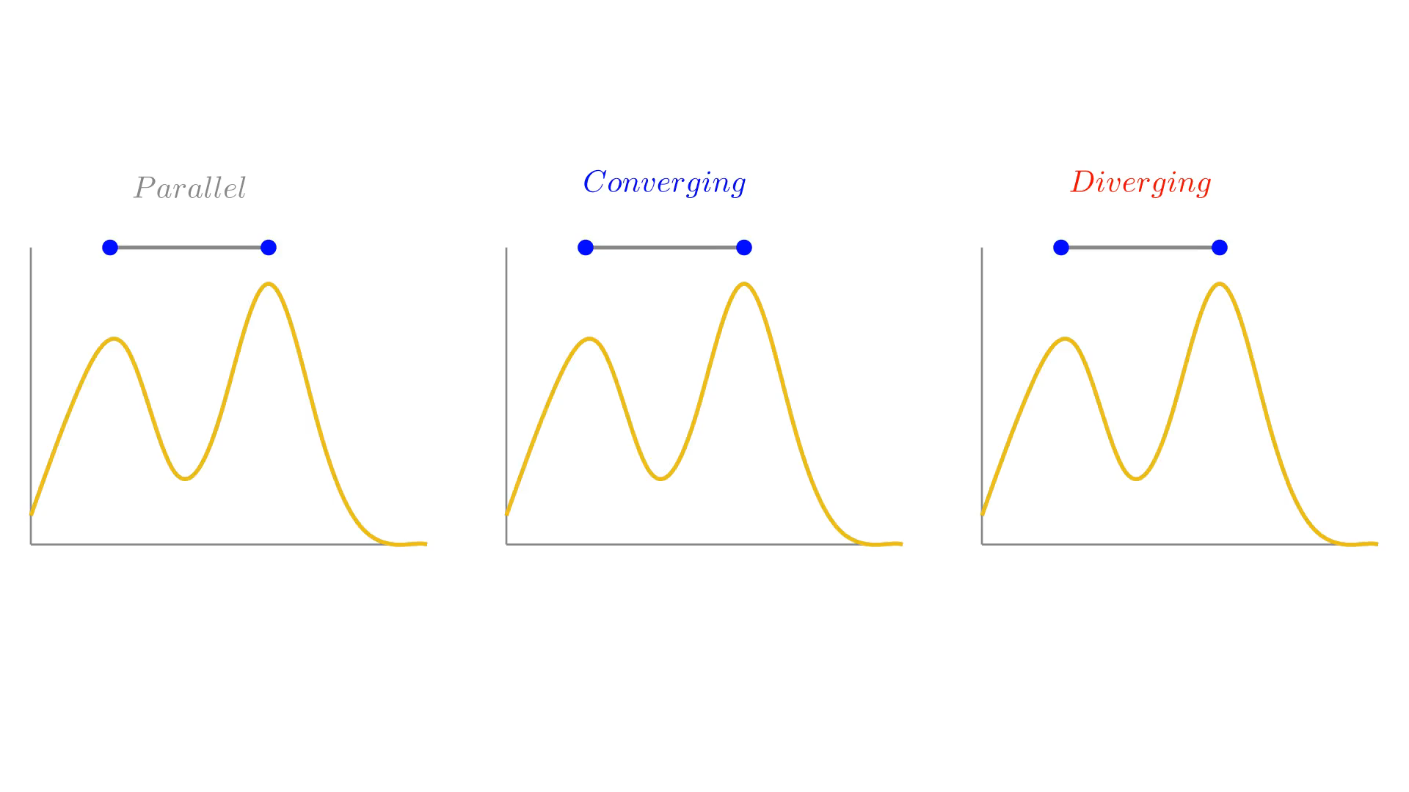

We analysed the movement of the peaks in bimodal distributions.
$$δT_{cold}=μ_{cold}^{future}−μ_{cold}^{historical}$$
$δT_{hot} =$ $μ_{hot}^{future}−μ_{hot}^{historical}$
$$ΔT=δT_{cold}−δT_{hot}$$
Warmer cold and hot periods.
Less cold extremes and warmer climates.
More hot extremes and overall warmer climates.

Slide 14
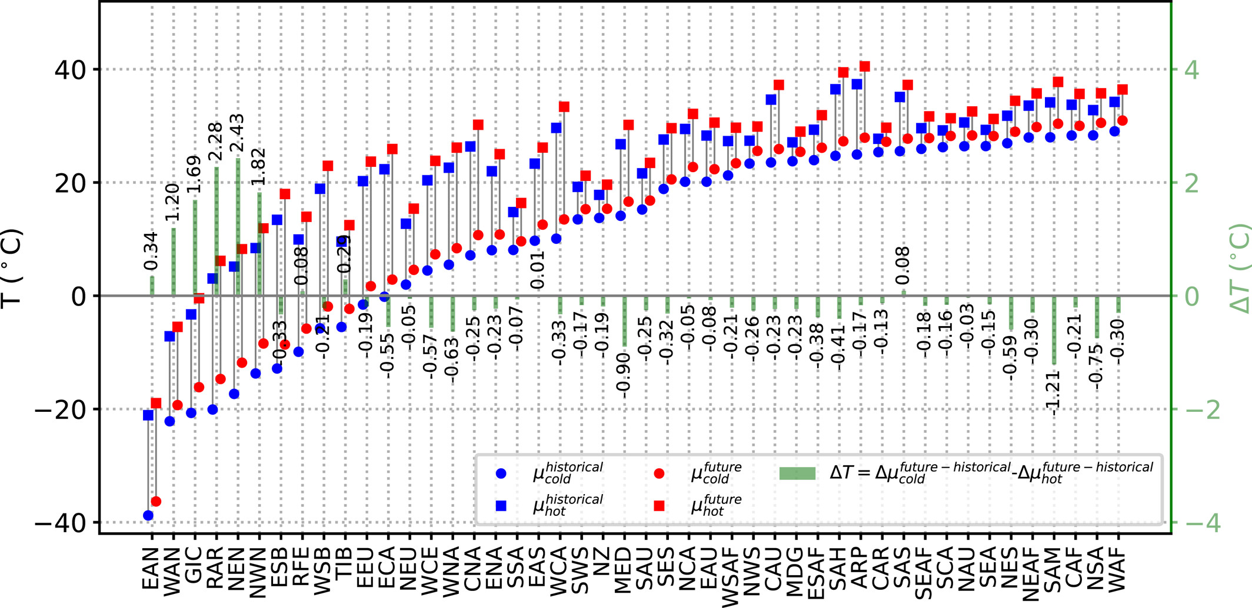
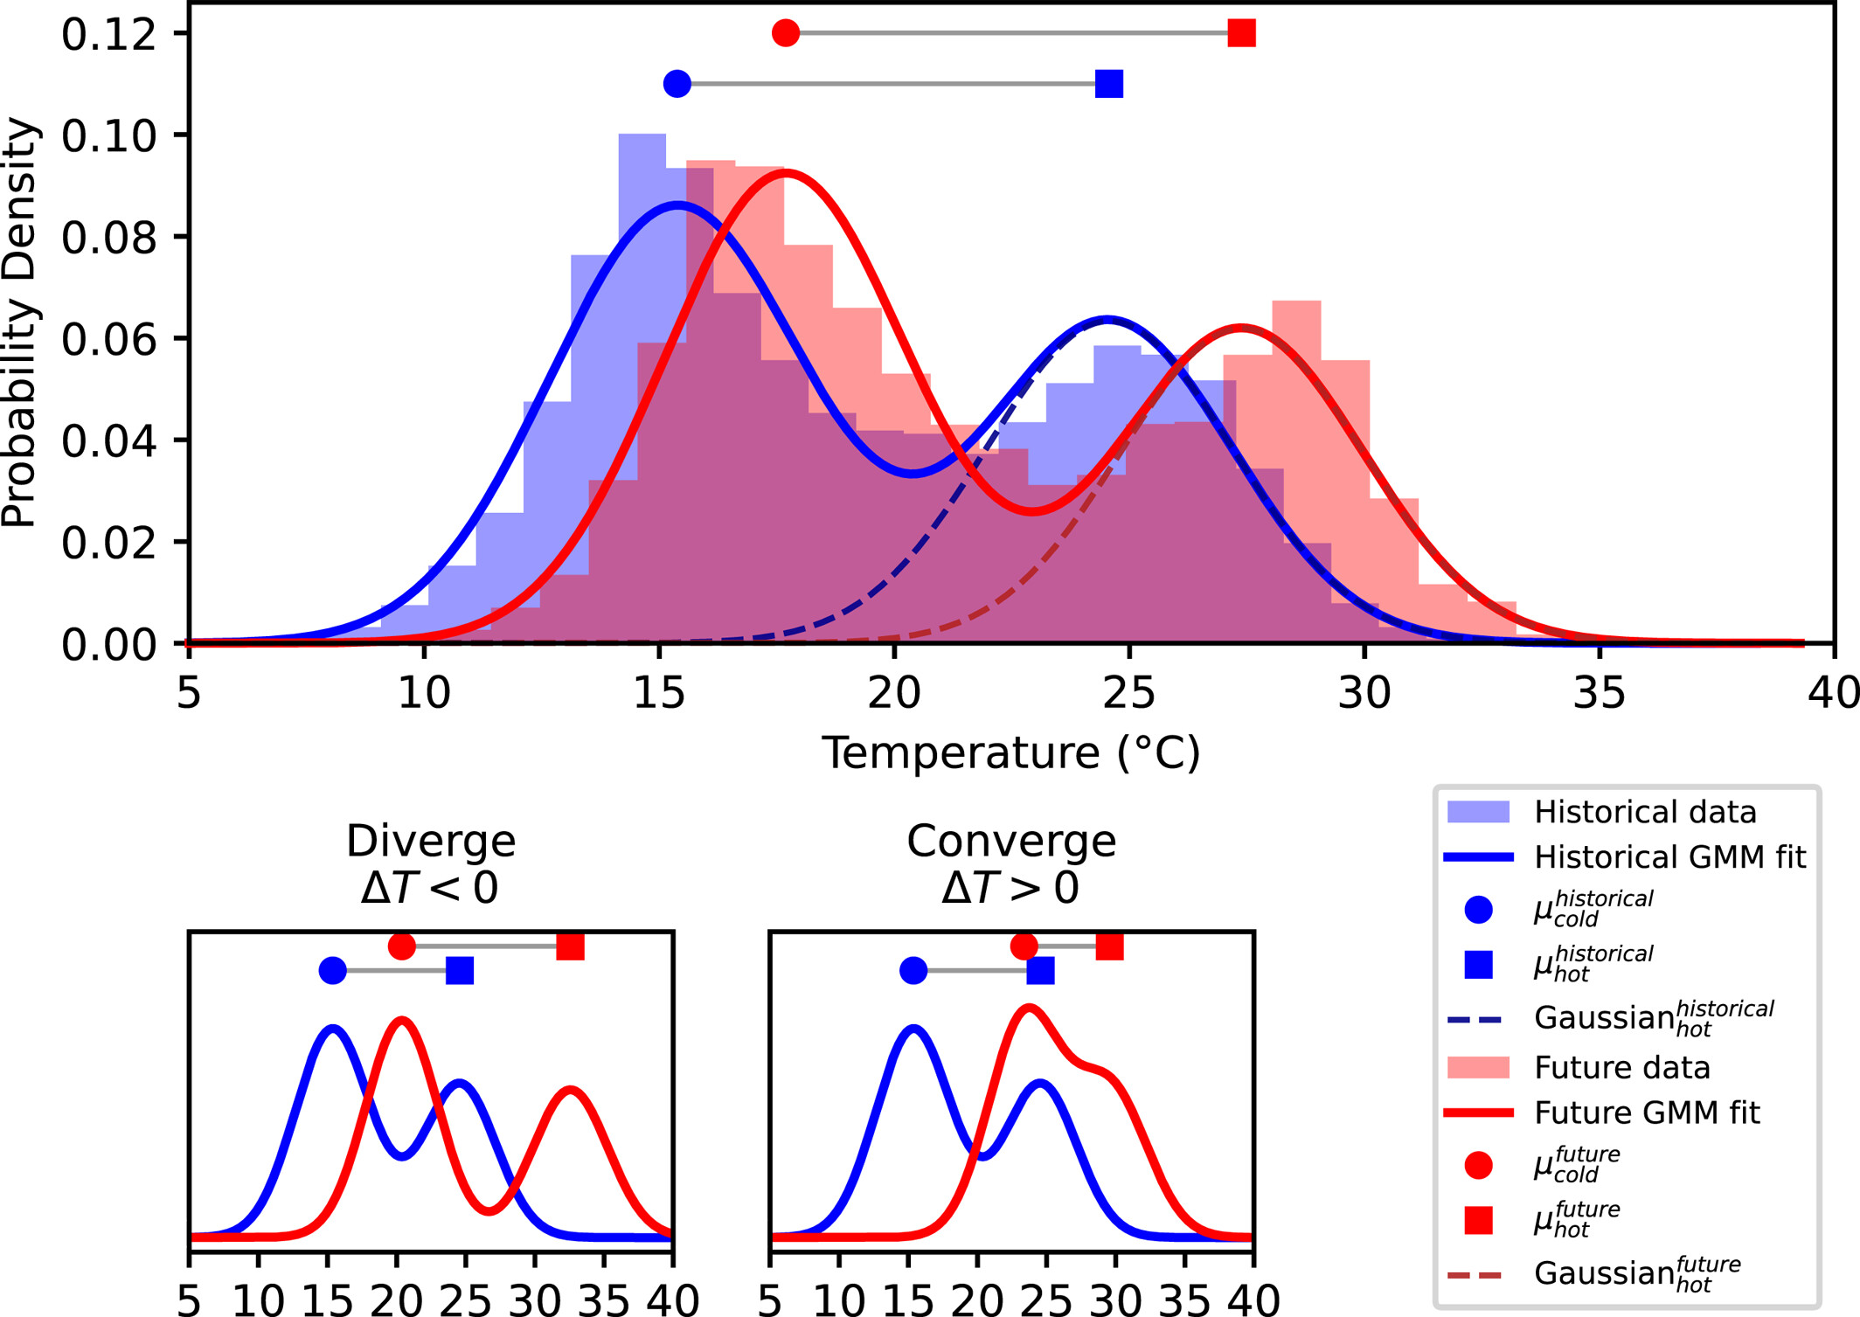




In high latitudes, cold days are getting warmer faster than hot days, whereas it is the opposite in low latitudes.
High latitudes
Low latitudes
$$ΔT$$
Diverging
more extremely
hot temperatures.
Converging
Less cold extremes, warmer climates.
Notes:
Peaks in high latitudes are converging, which introduce less cold extremes and warmer climates.
Diverging peaks in tropical regions will result in more extreme hot temperatures.

Slide 15
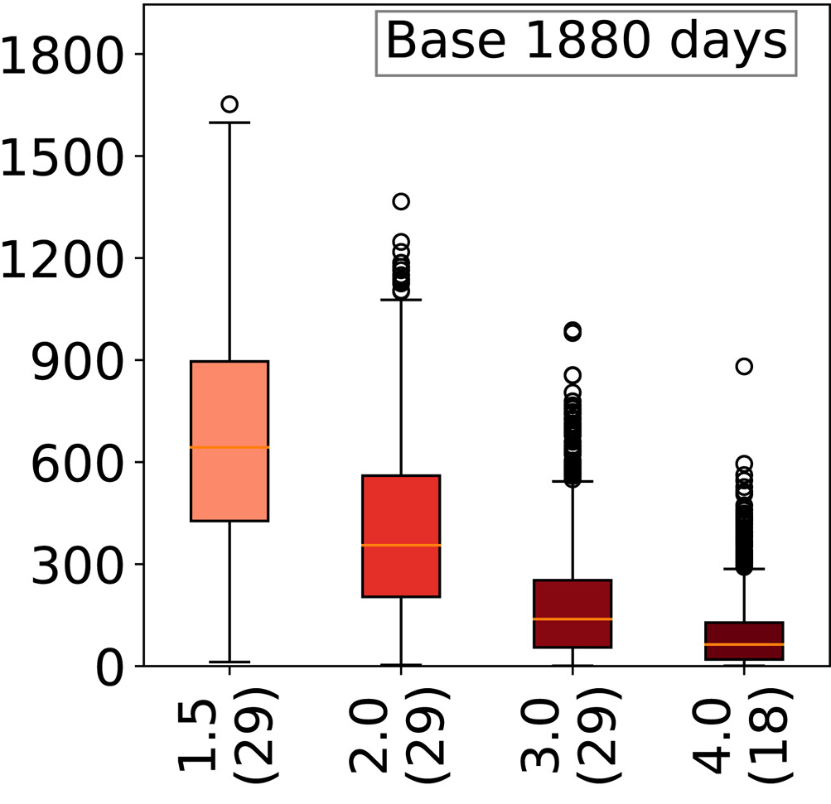
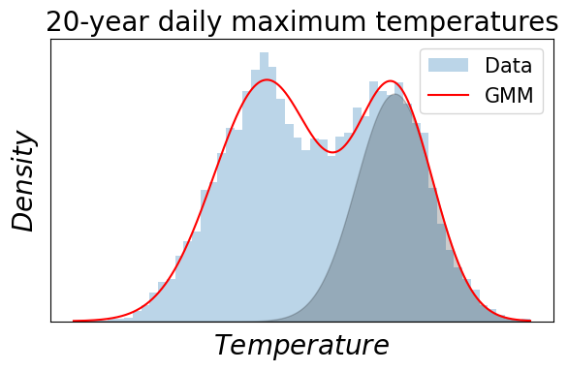
Return period of extreme events will increase.
10-year events
Global historical median (mean) ‘year’ length is 188 (197) days. A ‘year’ is defined as the number of days under hot Gaussian component.
More Frequent
Occurrence (day)
Global Warming Levels (⁰C) (# of datasets)
Globally, return period of 10-year events will increase almost 3-fold under GWL1.5⁰C.
Notes:
Orange line is median.
Length of a year can be calculated for each region. I am using global median as the return periods are medians.
Box is interquantile range.
Calculated for all the extreme events but only will show 2 of the return periods, 5 and 10-year

Slide 16
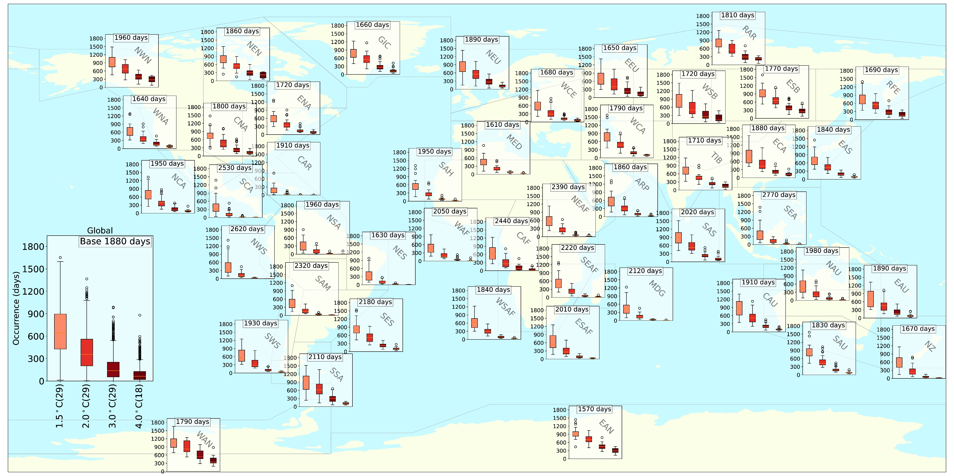
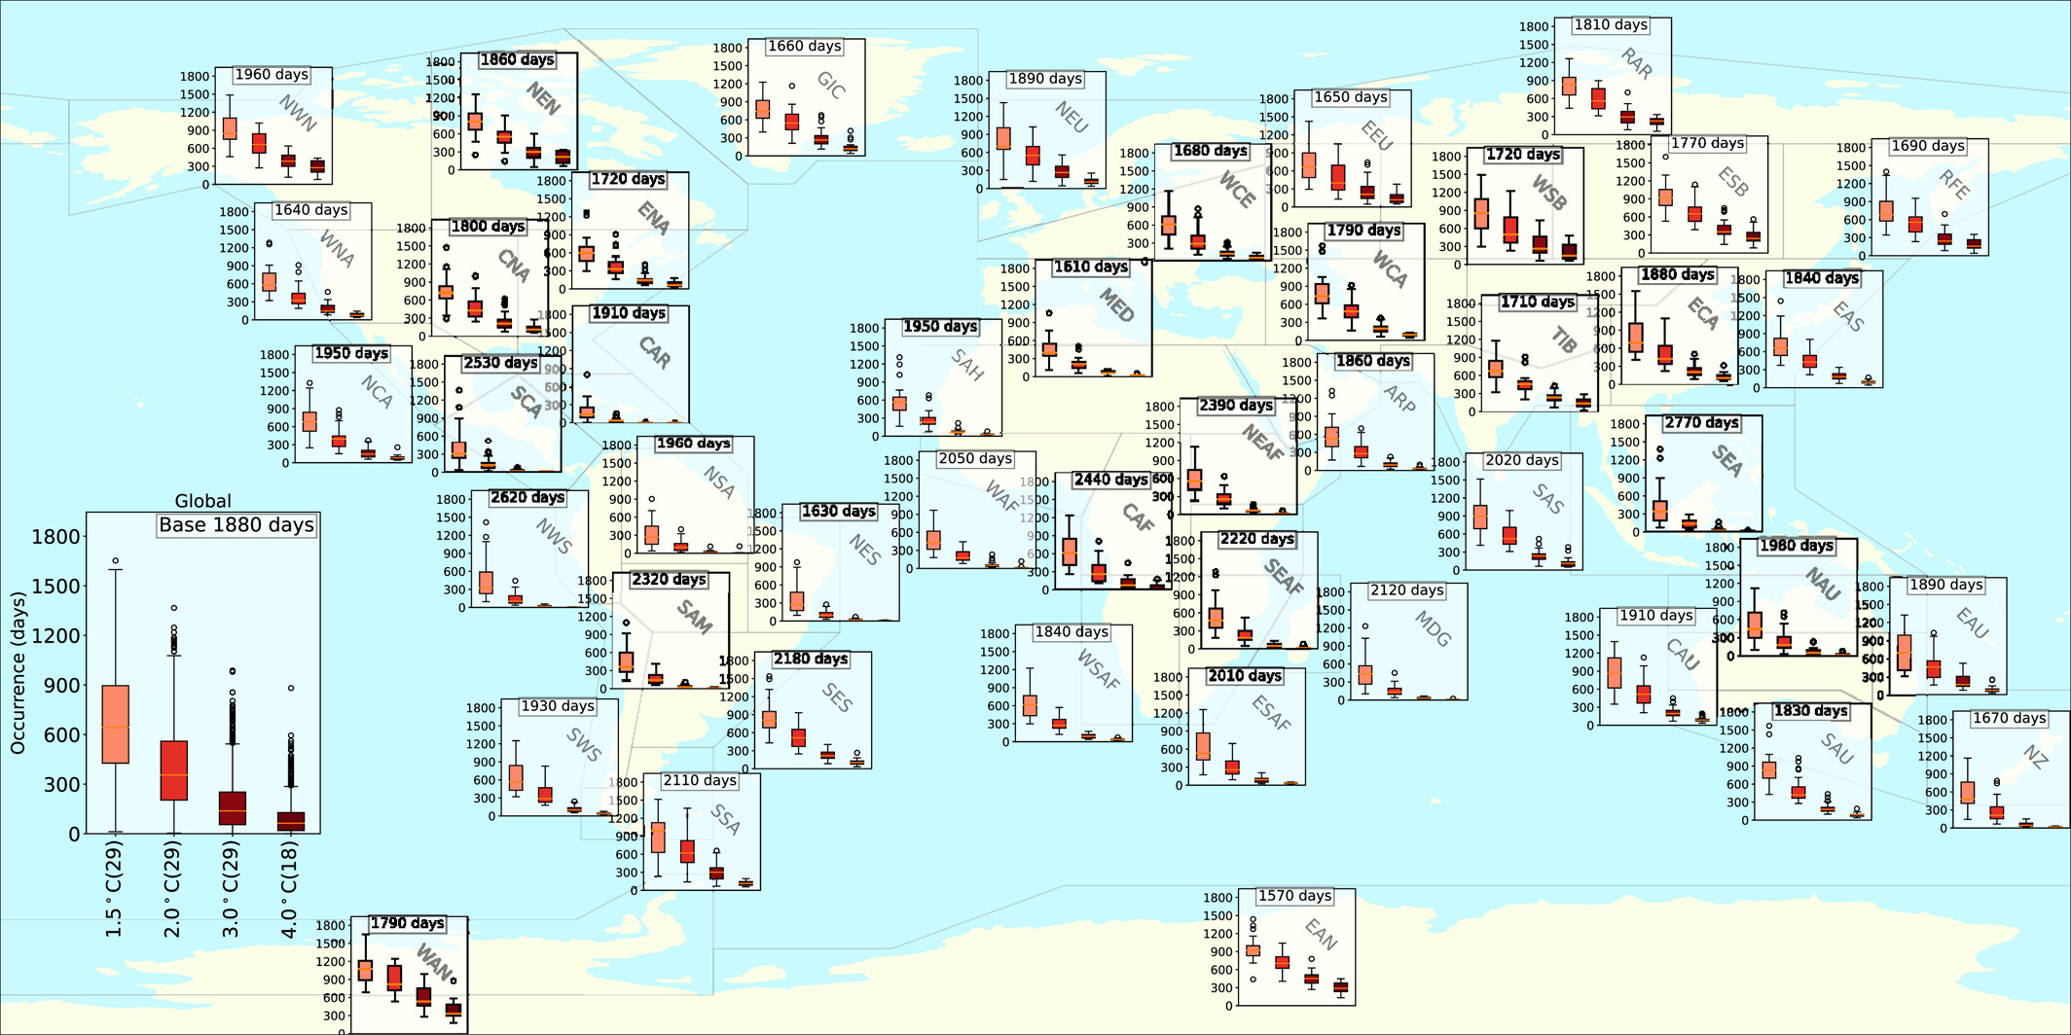
10-year events will occur about every 3 years instead of 10 years.
Paçal, A., Hassler, B., Weigel, K., Kurnaz, M. L., Wehner, M. F., & Eyring, V. (2023). Detecting Extreme Temperature Events Using Gaussian Mixture Models. Journal of Geophysical Research: Atmospheres, 128, e2023JD038906. https://doi.org/10.1029/2023JD038906
SSP5-8.5
Notes:
Plots have same y-axis
1-year, 5 year, 10-year and 20-year events are getting more frequent in all regions.
Changes are getting more pronounced in low latitudes compared to high latitudes.
Polar regions have a wider spread.
Low latitudes have more increase, boxes are closer to zero.

Slide 17
CAR region has the highest increase in 10-year event.
Paçal, A., Hassler, B., Weigel, K., Kurnaz, M. L., Wehner, M. F., & Eyring, V. (2023). Detecting Extreme Temperature Events Using Gaussian Mixture Models. Journal of Geophysical Research: Atmospheres, 128, e2023JD038906. https://doi.org/10.1029/2023JD038906
SSP5-8.5
Notes:
Plots have same y-axis
1-year, 5 year, 10-year and 20-year events are getting more frequent in all regions.
Changes are getting more pronounced in low latitudes compared to high latitudes.
Polar regions have a wider spread.
Low latitudes have more increase, boxes are closer to zero.

Slide 18
WCE region has a higher increase compared EEU and NEU.
Paçal, A., Hassler, B., Weigel, K., Kurnaz, M. L., Wehner, M. F., & Eyring, V. (2023). Detecting Extreme Temperature Events Using Gaussian Mixture Models. Journal of Geophysical Research: Atmospheres, 128, e2023JD038906. https://doi.org/10.1029/2023JD038906
SSP5-8.5
Notes:
Plots have same y-axis
1-year, 5 year, 10-year and 20-year events are getting more frequent in all regions.
Changes are getting more pronounced in low latitudes compared to high latitudes.
Polar regions have a wider spread.
Low latitudes have more increase, boxes are closer to zero.

Slide 19
The smallest increase in hot extremes is observed in WAN region.
Paçal, A., Hassler, B., Weigel, K., Kurnaz, M. L., Wehner, M. F., & Eyring, V. (2023). Detecting Extreme Temperature Events Using Gaussian Mixture Models. Journal of Geophysical Research: Atmospheres, 128, e2023JD038906. https://doi.org/10.1029/2023JD038906
SSP5-8.5
Notes:
Plots have same y-axis
1-year, 5 year, 10-year and 20-year events are getting more frequent in all regions.
Changes are getting more pronounced in low latitudes compared to high latitudes.
Polar regions have a wider spread.
Low latitudes have more increase, boxes are closer to zero.

Slide 20




Summary of the 1st study
Extreme events can be determined with GMM which conserves the information from a grid’s temperature distribution.
GMM can be used to define the length of the analysis period instead of using fixed seasonal definitions. Block maxima methods consider only the hottest, while GMM considers all days.
Daily maximum near-surface air temperature data follow mostly a bimodal distribution.
Bimodal peaks are diverging in low latitudes (more hot extremes) converging in polar regions (warmer climate, less cold extremes).
Extreme temperature events are getting more frequent in all regions.
Notes:
Cold days are getting warmer faster than hot days in high latitudes, whereas it is the opposite in low latitudes.
Onsets and length of seasons are predicted to change with climate change. The definition of current seasonal periods will not necessarily be valid for future climates.
One loses most of the data with current extreme event indices. The higher increase in our method compared to IPCC AR6 can most likely be explained by the fact that GMM considers all days hotter than the threshold, while the block maxima method only uses the maximum of a block.

Slide 21






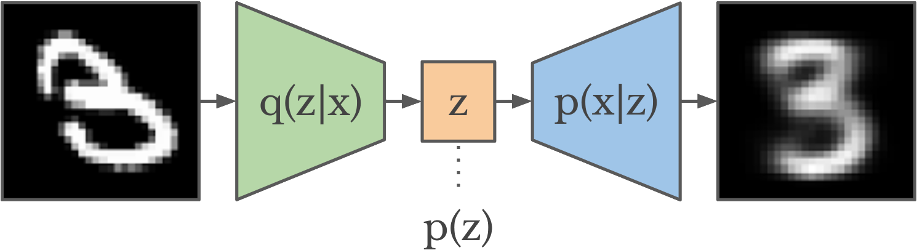
Ideas for second study: Detecting and Understanding Heatwaves using ML
Can we find heatwaves without using the heatwave definitions?
Climatological
National
Health-based
HUMIDEX
Heat-Index
No labelled dataset
Variational Autoencoders

Slide 22
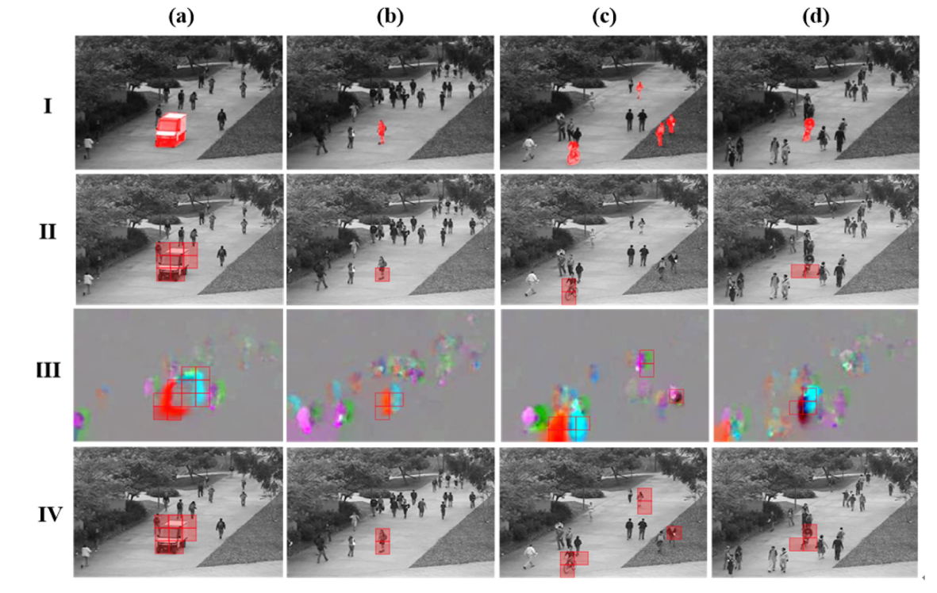
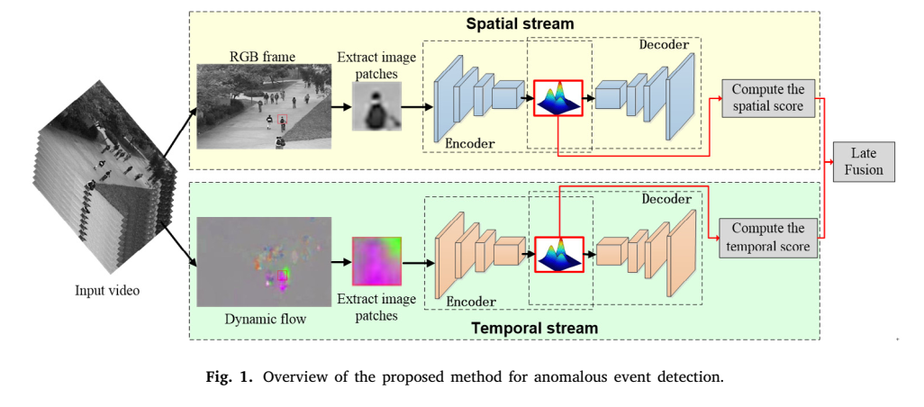
Can we approach the heatwave detection problem as a video anomaly detection?
Yaxiang Fan, Gongjian Wen, Deren Li, Shaohua Qiu, Martin D. Levine, Fei Xiao, Video anomaly detection and localization via Gaussian Mixture Fully Convolutional Variational Autoencoder, Computer Vision and Image Understanding, Volume 195, 2020, 102920, ISSN 1077-3142, https://doi.org/10.1016/j.cviu.2020.102920. (https://www.sciencedirect.com/science/article/pii/S1077314218302674)

Slide 23



VAE-LSTM with GMM latent space
Train the model with historical climate data to learn “normal”
Whole region(Europe) or sampled from small subsets?
Training with climate data instead of indices
Test against known heatwaves
Heatwave onset, spread and decline
Understanding the heatwave
Causal analysis
Feature importance

Slide 24
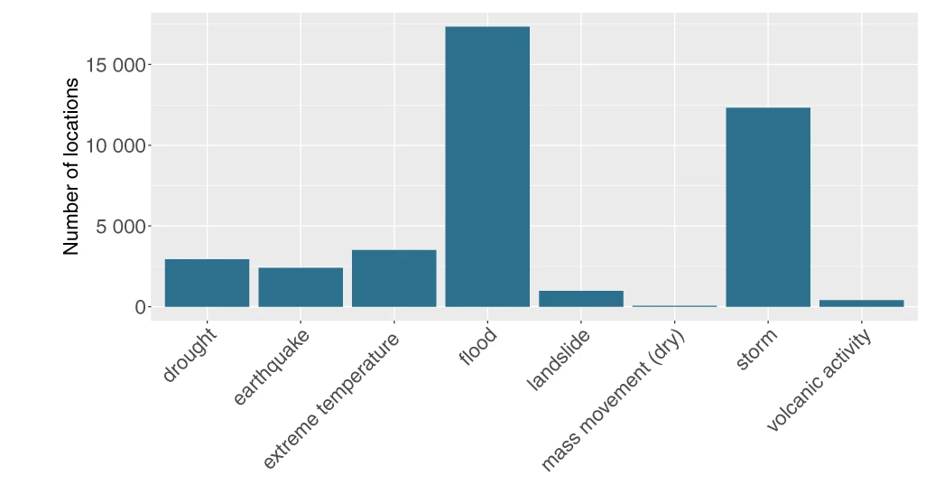
VAE-LSTM with GMM latent space: To-Do list
Training a simple VAE with non-heatwave location data
Evaluating with geocoded disasters dataset and heatwave indices
VEA-LSTM, GMM latent space
Explainability of the heatwaves
Suggestions, warning, corrections?
Rosvold, E.L., Buhaug, H. GDIS, a global dataset of geocoded disaster locations. Sci Data 8, 61 (2021). https://doi.org/10.1038/s41597-021-00846-6

Slide 26
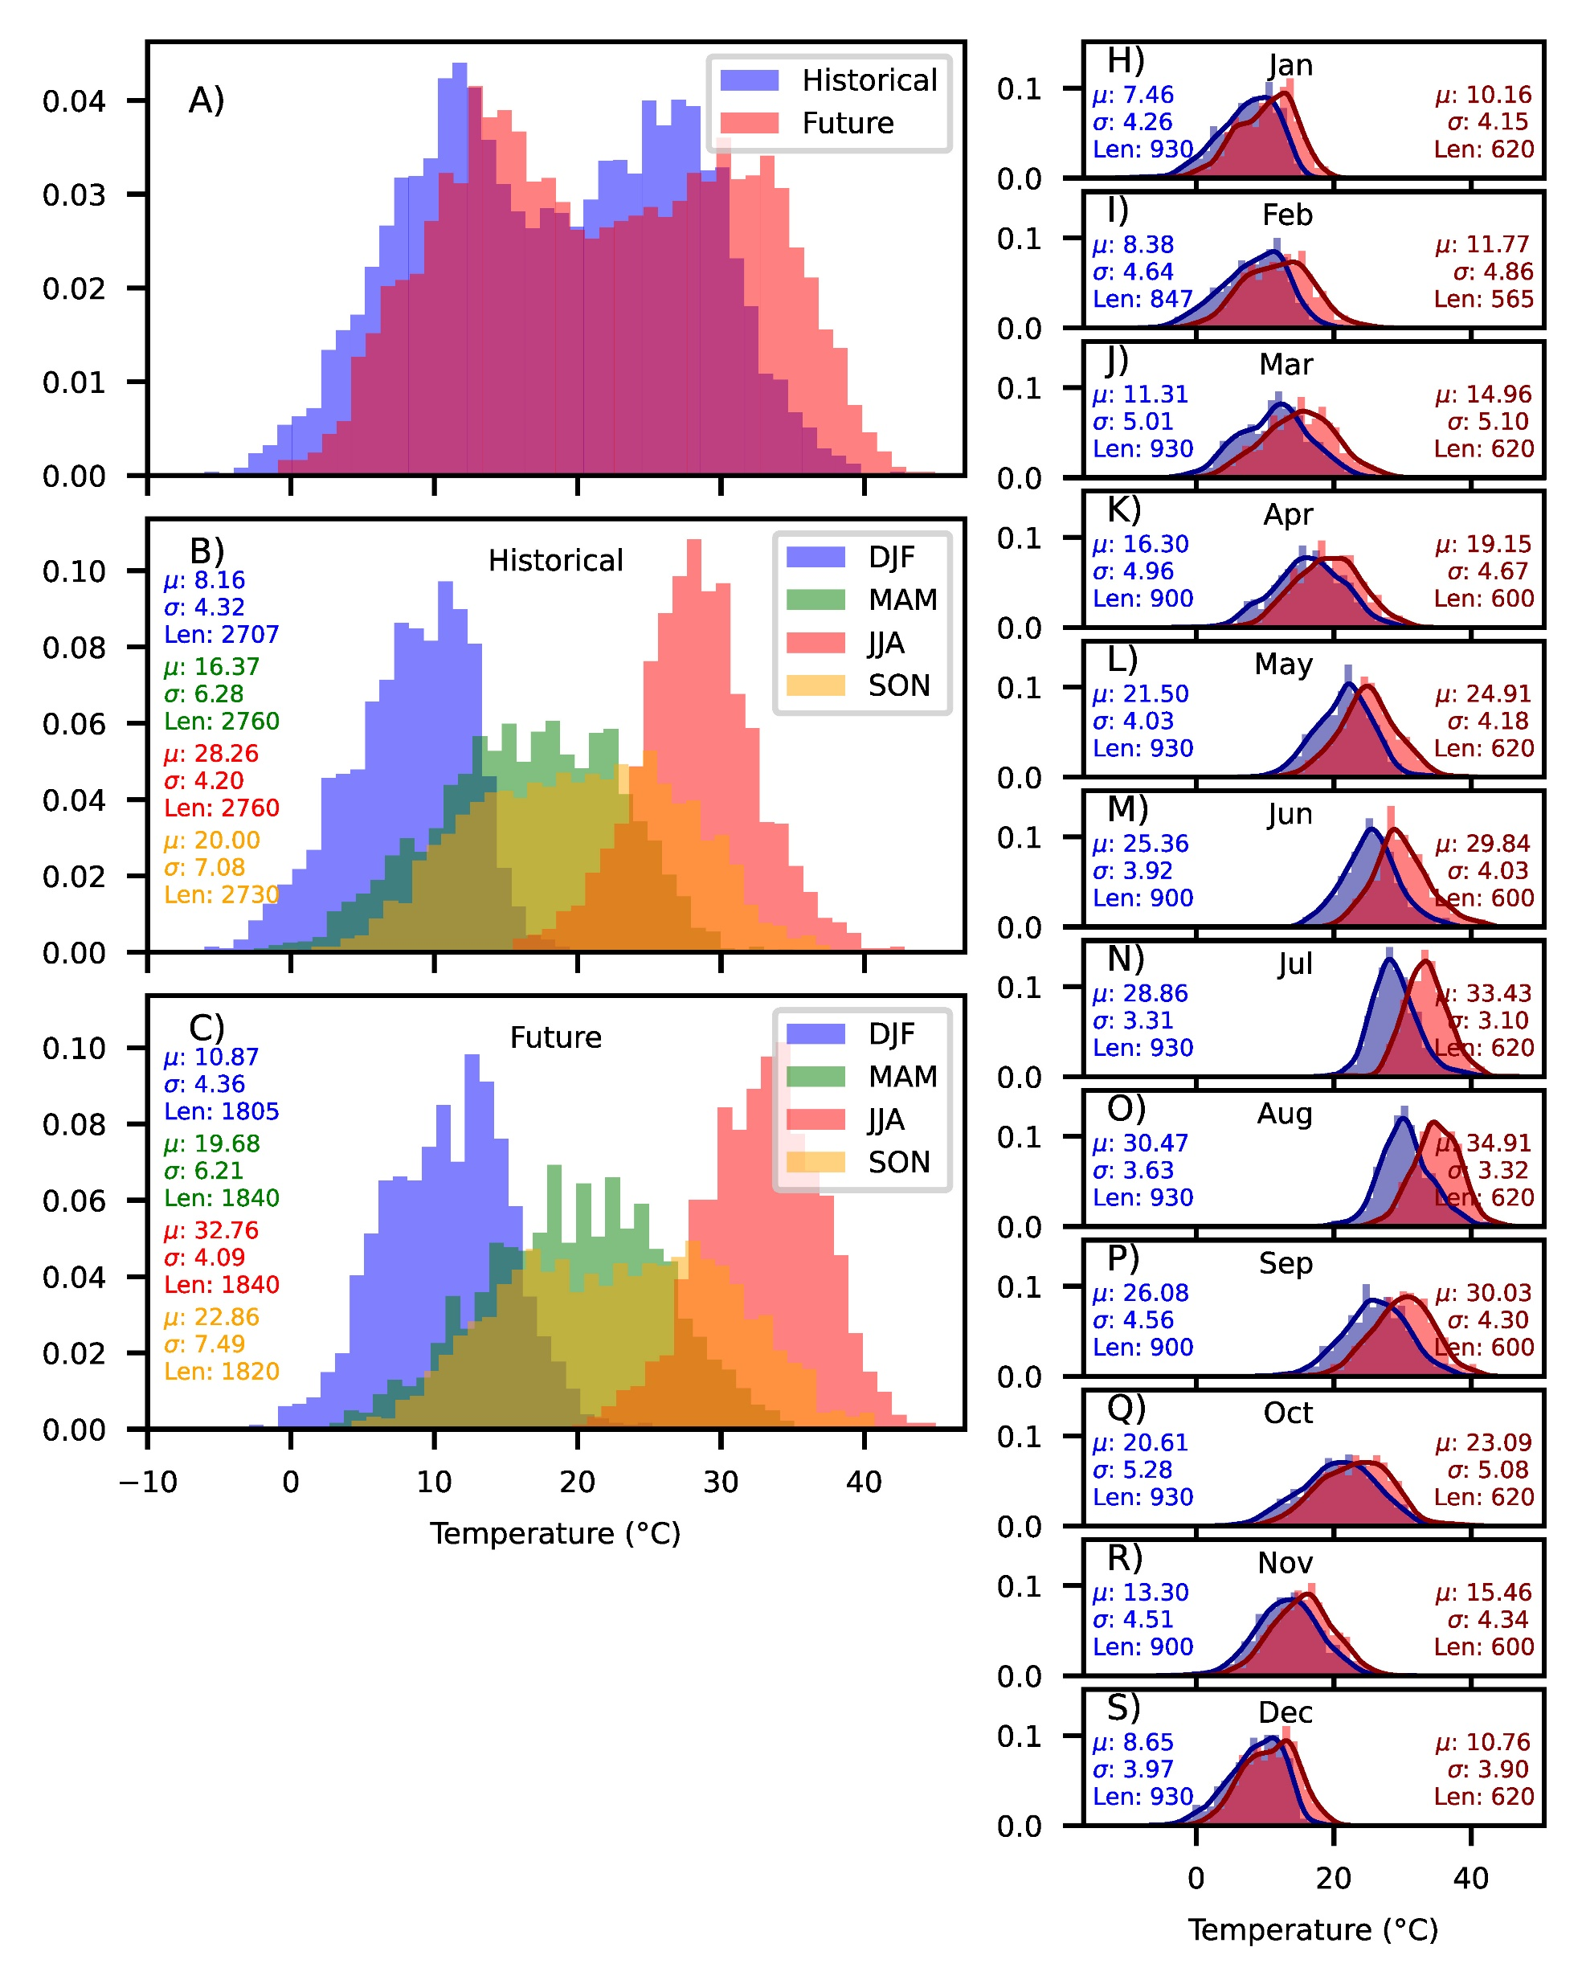

Slide 27
References
Eyring, V., Bony, S., Meehl, G. A., Senior, C. A., Stevens, B., Stouffer, R. J., and Taylor, K. E.: Overview of the Coupled Model Intercomparison Project Phase 6 (CMIP6) experimental design and organization, Geosci. Model Dev., 9, 1937–1958, https://doi.org/10.5194/gmd-9-1937-2016, 2016.
Hauser, Mathias, Engelbrecht, Francois, & Fischer, Erich M. (2022). Transient global warming levels for CMIP5 and CMIP6 (v0.3.0). Zenodo. https://doi.org/10.5281/zenodo.7390473
Andela, Bouwe, Broetz, Bjoern, de Mora, Lee, Drost, Niels, Eyring, Veronika, Koldunov, Nikolay, Lauer, Axel, Mueller, Benjamin, Predoi, Valeriu, Righi, Mattia, Schlund, Manuel, Vegas-Regidor, Javier, Zimmermann, Klaus, Adeniyi, Kemisola, Arnone, Enrico, Bellprat, Omar, Berg, Peter, Bock, Lisa, Caron, Louis-Philippe, … Kazeroni, Rémi. (2022). ESMValTool (v2.5.0). Zenodo. https://doi.org/10.5281/zenodo.6359405
Sardeshmukh, P. D., Compo, G. P., & Penland, C. (2015). Need for Caution in Interpreting Extreme Weather Statistics, Journal of Climate, 28(23), 9166-9187. doi: https://doi.org/10.1175/JCLI-D-15-0020.1
Michael Wehner, Dáithí Stone, Hideo Shiogama, Piotr Wolski, Andrew Ciavarella, Nikolaos Christidis, Harinarayan Krishnan, Early 21st century anthropogenic changes in extremely hot days as simulated by the C20C+ detection and attribution multi-model ensemble, Weather and Climate Extremes, Volume 20, 2018, Pages 1-8, ISSN 2212-0947, https://doi.org/10.1016/j.wace.2018.03.001.
Vikki Thompson et al. ,The 2021 western North America heat wave among the most extreme events ever recorded globally.Sci. Adv.8, eabm6860(2022).DOI:10.1126/sciadv.abm6860
Wang, J., Guan, Y., Wu, L., Guan, X., Cai, W., Huang, J., et al. (2021). Changing lengths of the four seasons by global warming. Geophysical Research Letters, 48, e2020GL091753. https://doi.org/10.1029/2020GL091753

